Slide 1
ALOHA Packet System With And Without Slots And Capture
Gediminas Viliunas

Slide 2
Content

Slide 3
ALOHA packet systems
ALOHA packet systems were originally described by Abramson
a single broadcast channel is shared by a number of communicating devices
every device transmits its packets independent of any other device or an y specific time
device then times out for receiving an acknowledgment . If an acknowledgment is not received, it is assumed that a collision occured

Slide 4
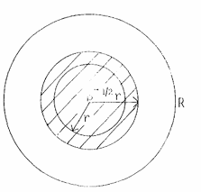
Capture
distance factor and
random individual power variations (less than 1 .5 - 3 db)
Notes:
capture ratio . Two major factors affect the power received

Slide 5

Definitions
$CR$ →Capture Ratio
$β$ Power Ratio
$r^{2}$
$γ$
$σ$
$q$

Slide 6
Asynchronous Slots

Slide 7
Synchronous Slots

Slide 8
Other Population Densitie s

Slide 9
Maximum o for Slots

Slide 10
Delay

Slide 11
satellite Delay

Slide 12
Ground Radio Delay

Slide 13
Operating point

Slide 14
Slot Padding

Slide 15
Conclusion

